Slide 1
Platform for Selecting Best Embedding Model
Jan Wangrat, Jayasurya Marasani, Sneharajalakshmi Palanisamy, Arunkumar Murugesan

Slide 2
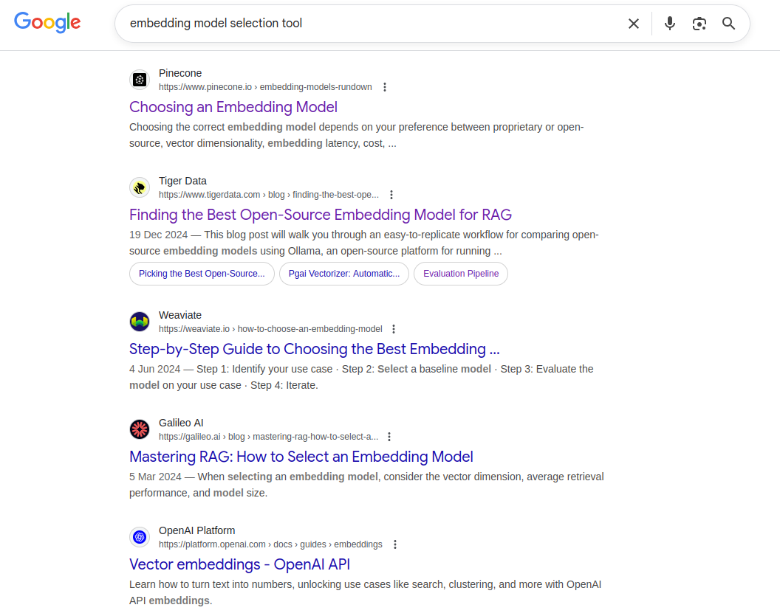
Idea
Platform that:
Takes data from the user for their task (retrieval or classification)
Selects suitable models from MTEB leaderboard and benchmarks them on user’s data.
Recommends the best model under constraints (quality, cost, size)

Slide 3
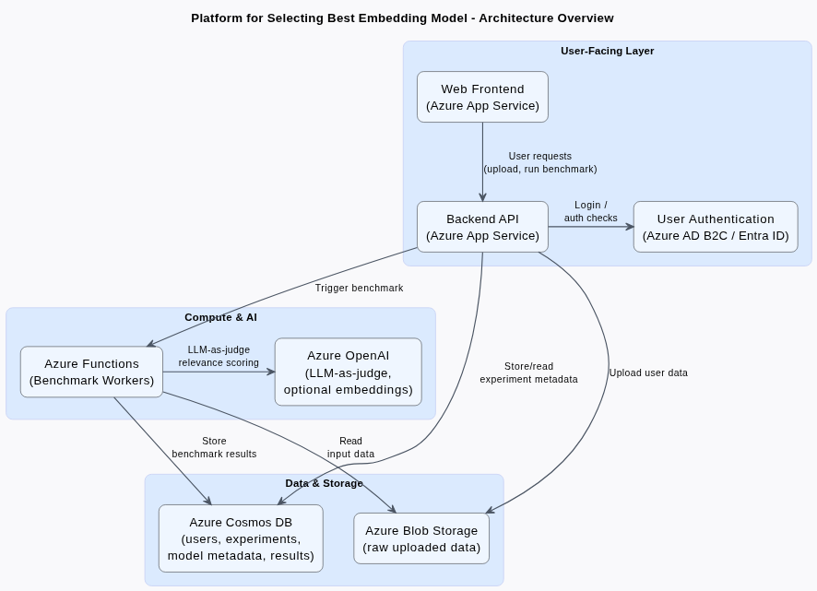
High-Level Architecture
User-facing layer
Azure App Service - hosts the web frontend and backend APIs
Azure AD B2C / Entra ID - user authentication and login
Data & metadata storage
Azure Blob Storage – raw uploaded files (queries, documents, labels)
Azure Cosmos DB – user info, experiments, model metadata and benchmark results
Compute & AI
Azure Functions – serverless workers for heavy benchmarking
Azure OpenAI Service – LLM-as-judge and (optionally) embeddings

Slide 4
Future Scope:
Azure Semantic Kernel: Wraps Azure OpenAI to create an agent that acts as a guide to the user
Azure Service Bus: Pushes experiment jobs to a queue and multiple Azure Functions instances consume the queue and run benchmarks.
Fine-tuning Service: Azure Functions trigger Azure ML pipelines for embedding model fine-tuning.
Expanded Evaluation: Separate Functions for
Recall@10 when relevance labels are available
benchmarks for classification(e.g: F1 score of Logistic Regression/SVM classifier on embeddings).
Domain specific keyword tests (e.g., positive/negative keyword probes).

